Slide 1

Arboreal App
Transforming Urban Environmental Management
Sasha Stacie 230306
1

Slide 2
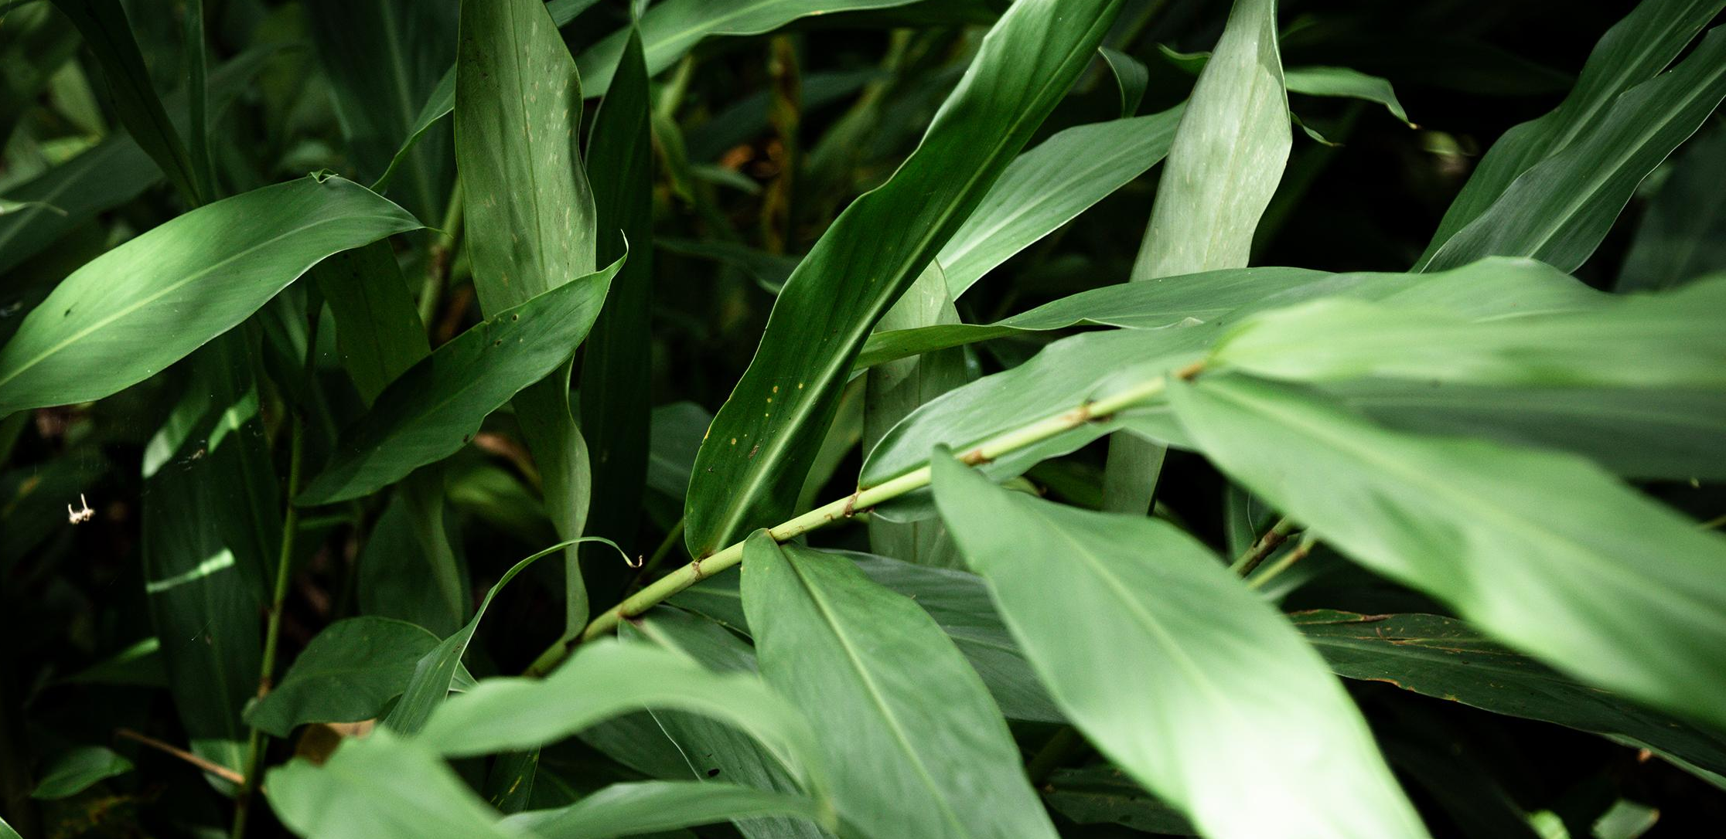
Understanding the Urban-Nature Disconnect
Application Idea:
An Educational, Easy-to-Use Platform.
Value Proposition: -Enrich Urban ecosystems
-Promote Biodiversity
-Facilitate Sustainable development
2
Notes:
Problem Definition
In our fast-paced urban environments, a significant disconnect exists between the youth and their knowledge of local tree species, indicating a wider gap in their connection with urban nature. This insight, garnered from extensive market research within the urban environmental management sector, forms the basis of my innovative solution - the Arboreal app.
Application Idea: An Educational, Easy-to-Use Platform
The Arboreal app is conceived as a user-friendly platform that transcends professional use, reaching students, environmentalists, and casual nature enthusiasts alike. By simplifying the identification of trees through a photo submission process, it leverages advanced image recognition and machine learning to provide not only education but also precise data for urban green space planning.
Value Proposition
The application promises to enrich urban ecosystems, promote biodiversity, and facilitate sustainable development through increased environmental awareness and targeted conservation efforts. The integration of Arboreal into urban planning and public engagement initiatives represents a step towards greener, more sustainable cities.

Slide 3
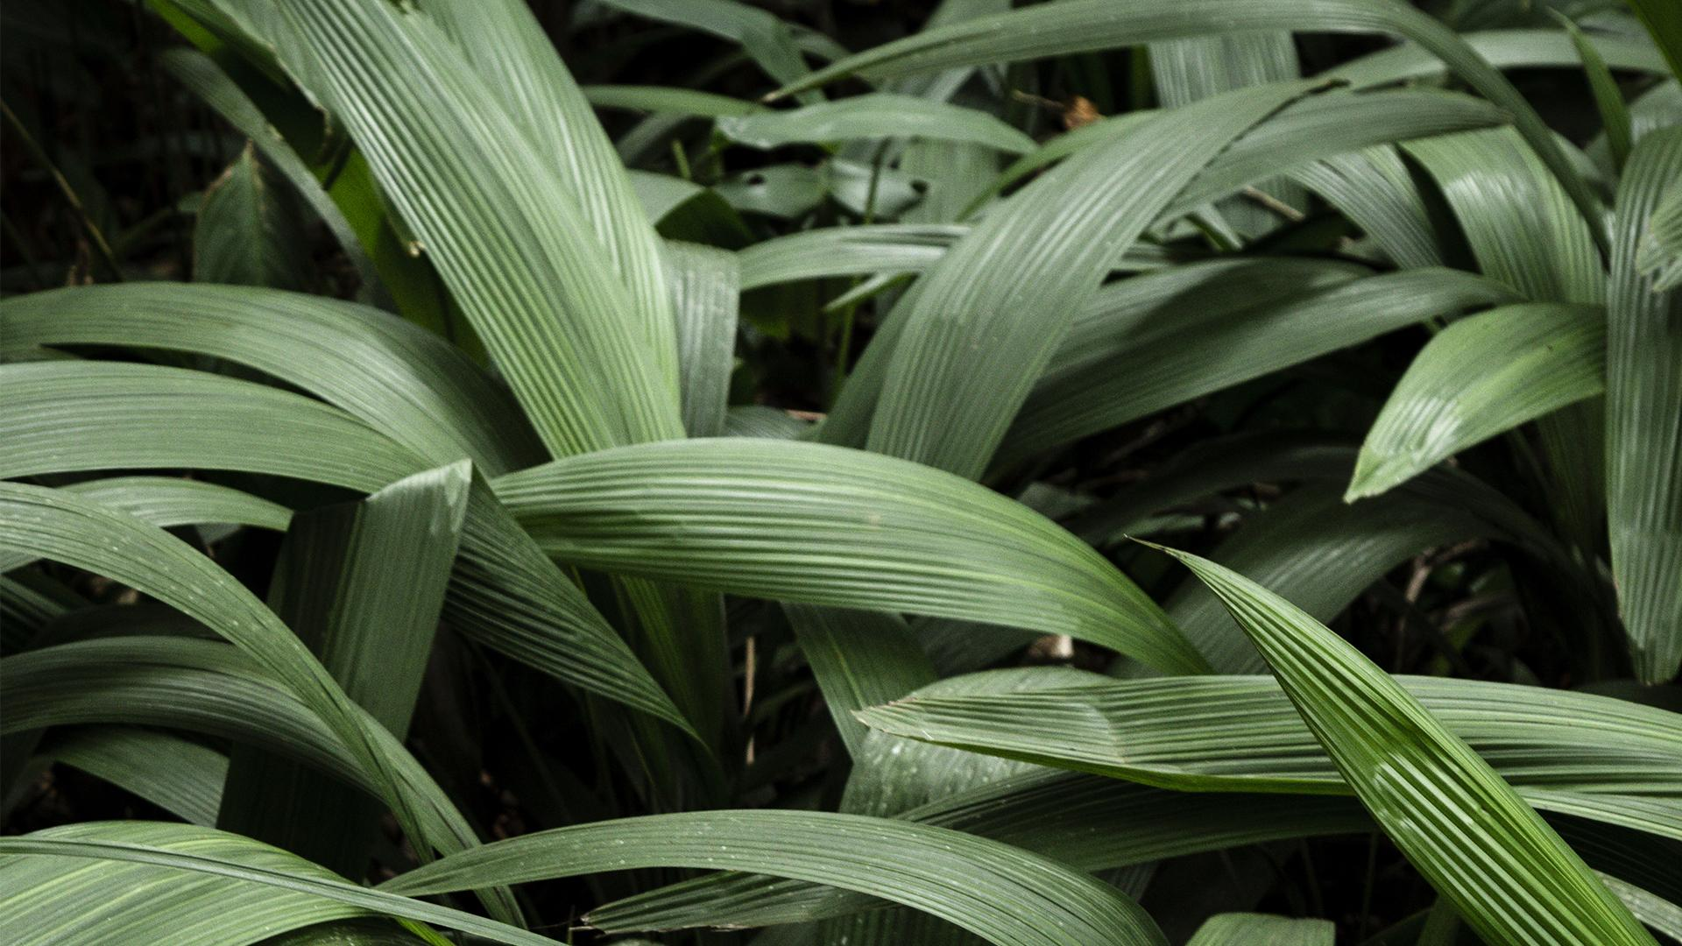
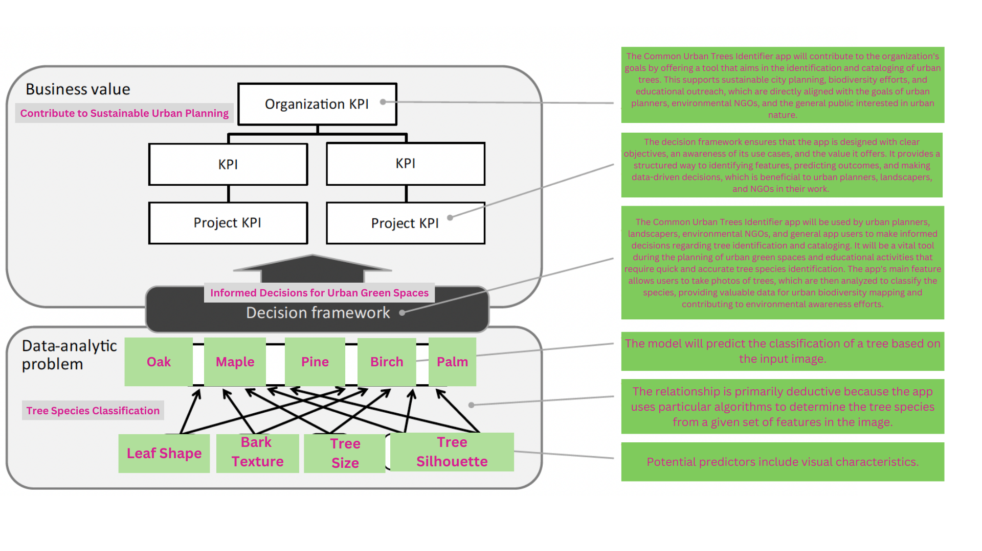
Business Understanding
Main Stakeholder: Urban Planners
They need efficient tools to maintain accurate tree inventories, crucial for smart urban planning and fostering biodiversity.
Data: Users upload images of trees, which are analysed using Convolutional Neural Networks (CNNs).
Analytics: The app provides instant, accurate tree identification
Process: This identification process supports urban planners, landscapers, and environmental NGOs.
System: Arboreal serves as an educational platform.
3
Notes:
Main Stakeholder: Urban Planners
The main stakeholder, urban planners, are at the forefront of integrating sustainable practices into city development. They need efficient tools to maintain accurate tree inventories, crucial for smart urban planning and fostering biodiversity.
The DAPS Diagram: Simplifying Urban Nature Engagement
Data: Users upload images of trees, which are analyzed using Convolutional Neural Networks (CNNs) to identify species by evaluating leaf shape, bark texture, and more.
Analytics: The app provides instant, accurate tree identification, streamlining urban biodiversity management and enhancing public nature engagement.
Process: This identification process supports urban planners, landscapers, and environmental NGOs in making informed decisions for urban green space development and maintenance.
System: Arboreal serves as an educational platform, enriching users' understanding of local biodiversity and fostering a deeper connection with their urban environments.

Slide 4

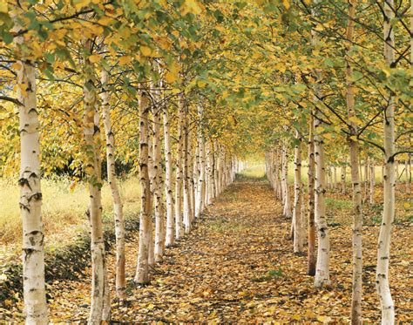
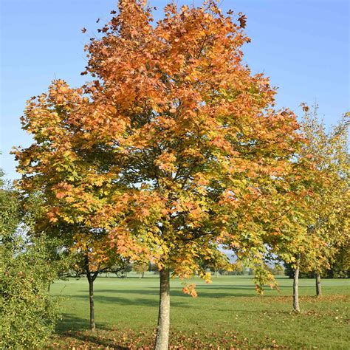
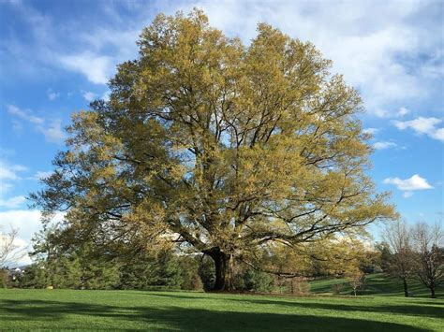
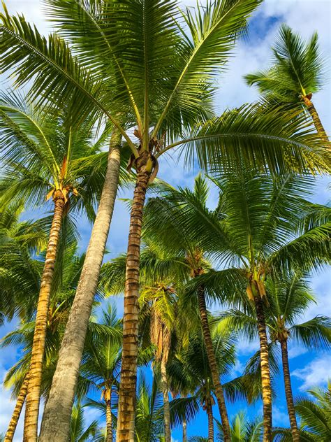
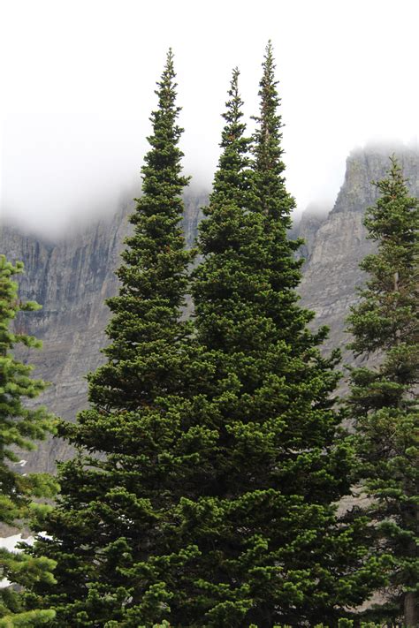
Urban Tree Species Classification
5 Classes: Birch, Maple, Oak, Palm, Pine
Images: Varied shots of leaves, barks, and tree silhouettes
Setting Benchmarks
Random Guess Baseline: 20%
Human-Level Performance (HLP): 68.18%
Basic MLP Performance: 54%
4
Notes:
Introduction : The Arboreal app’s classifies urban tree species from images.
Classification Details: I focused on five key species: Birch, Maple, Oak, Palm, Pine
These were chosen based on their prevalence and ecological significance in urban environments. The dataset is composed of about 200 images per class, providing a comprehensive basis for the classification problem.“
Baseline Accuracies : To understand the model's effectiveness, I’ve set three benchmarks:
a Random Guess Baseline at 20%, reflecting the chance accuracy in a 5-class problem;
Human-Level Performance at 68.18%, averaged from 11 respondents' accuracy;
Basic MLP Model's initial performance at 54%.
My objective was to exceed these benchmarks, particularly aiming to surpass human-level performance.

Slide 5
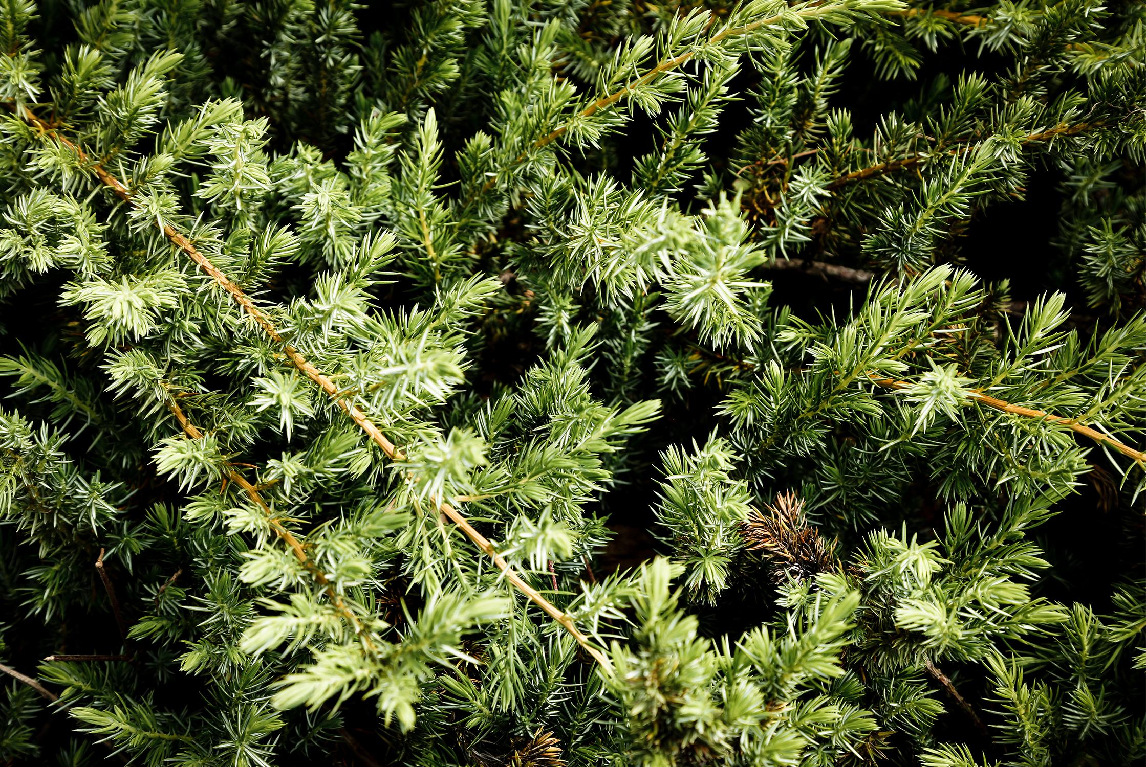
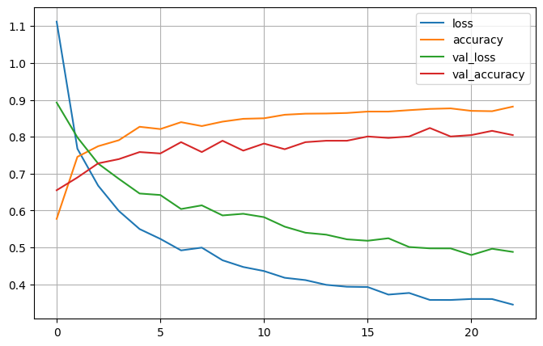
Model Overview
Dataset Preparation
Initial Model Setup
Baseline Performance
Iterative Improvements
Data Augmentation
Architecture Adjustments
Hyperparameter Tuning
Transfer Learning
The final iteration of the urban tree classification project
Refining the data augmentation parameters.
Incorporating transfer learning.
With an additional dropout layer.
86% accuracy
5
Notes:
I'm going to go through Model Creation Process:
Dataset Preparation: I started by assembling a diverse dataset, scraping web images of various tree species to ensure representation was balanced and bias minimized.
Initial Model Setup: My first step was establishing a simple Convolutional Neural Network (CNN) with essential layers such as convolutional, pooling, and fully connected layers, aiming to effectively capture the distinct features of different tree species.
Baseline Performance: This initial setup offered me a baseline understanding of the potential performance with a straightforward architecture.
Iterative Improvements:
Data Augmentation: To enhance the model's generalization, I implemented data augmentation techniques like rotation, zoom, and horizontal flipping, which notably increased the model's accuracy and reduced overfitting.
Architecture Adjustments: I experimented with adding more depth to the architecture and introduced dropout layers to stop overfitting. Tweaking the convolutional layers' filters and kernel sizes helped refine the feature extraction process.
Hyperparameter Tuning: Through hyperparameter tuning, including adjustments to learning rates, batch sizes, and optimizers, I optimized the model's performance.
Transfer Learning: Recognizing the advantages of pre-trained models, I utilized transfer learning with the architecture Exception . This significantly increased the model's accuracy by leveraging features learned from extensive image datasets.
In final iteration of my urban tree species classification, I enhanced the model's accuracy by refining the data augmentation parameters
incorporating transfer learning with an additional dropout layer. I adjusted the 'ImageDataGenerator' to include settings such as limited rotation, horizontal flipping, zooming, and brightness adjustments, creating a diverse and realistic dataset.
I utilized the Xception model, pre-trained on ImageNet, with the top layer excluded to serve as the feature extraction base. The model architecture included:
Global Average Pooling 2D: For reducing feature dimensions.
Dropout Layer (0.5): To prevent overfitting.
Output Layer: A dense softmax layer for class prediction.
Training involved using the Adam optimizer with a categorical cross-entropy loss, enhanced by callbacks for performance monitoring. The final model achieved an 86% accuracy, demonstrating its effectiveness in identifying various tree species accurately and its potential application in urban biodiversity mapping and sustainable city planning.
The training loss dropped smoothly and the validation loss followed a similar pattern, which suggests my model is learning effectively without fitting to irrelevant details. Both the training and validation accuracy rose quickly at first and then settled into a stable pattern. This levelling off is good, it means the model is not just memorizing the training images, but actually learning to recognize the differences between tree species.

Slide 6
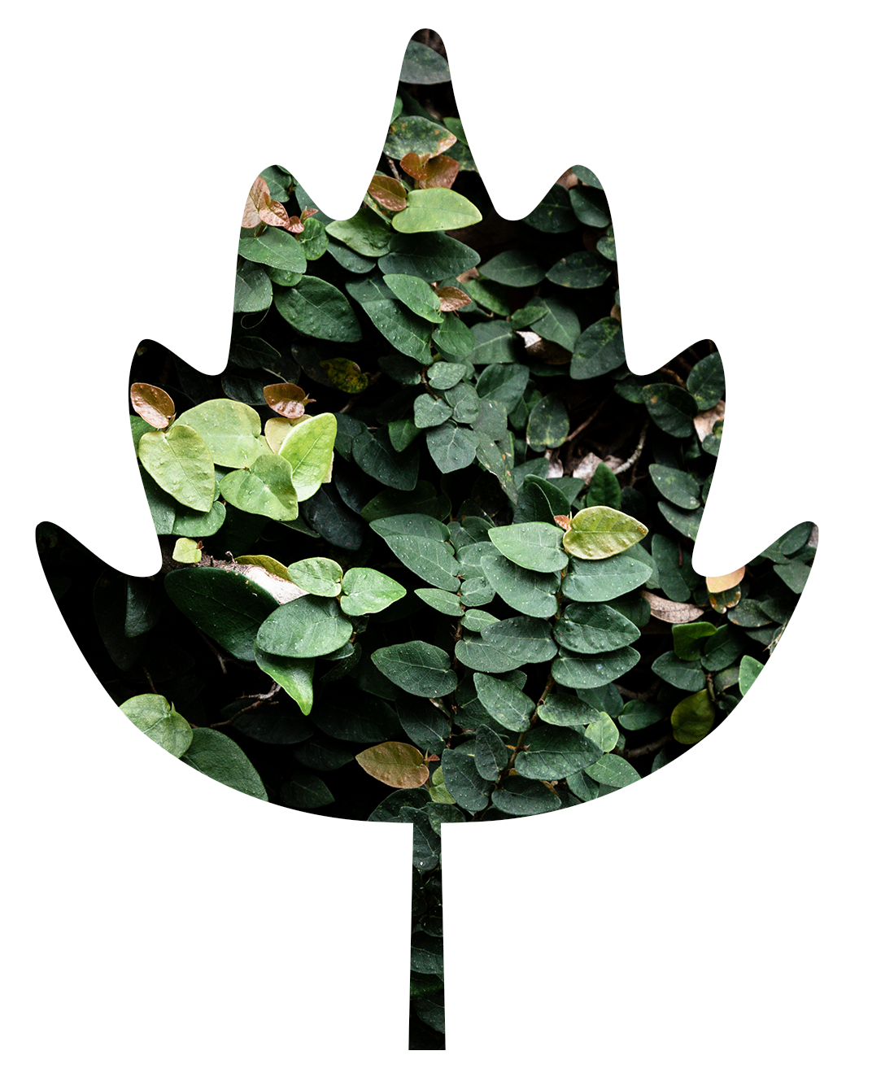
Balancing Accuracy and Interpretability
in Tree Species Identification
Accuracy
Interpretability
Accuracy ensures reliable urban biodiversity cataloging
Interpretability builds trust and understanding
Importance in context
Striking a Balance
Accuracy is important for precise management actions; however, interpretability cannot be overlooked as it fosters stakeholder adoption and confidence."
My approach integrates both high accuracy and high interpretability.
6
Notes:
Accuracy: "Accuracy ensures reliable urban biodiversity cataloging, critical for effective urban planning and ecosystem management."
Interpretability: "Interpretability builds trust and understanding, enabling stakeholders to make informed decisions based on model predictions.“
Importance in Context:
"Accuracy is important for precise management actions; however, interpretability cannot be overlooked as it fosters stakeholder adoption and confidence.“
Striking a Balance:
“My approach integrates both high accuracy and high interpretability to meet the dual demands of precision and transparency in urban environmental management."

Slide 7
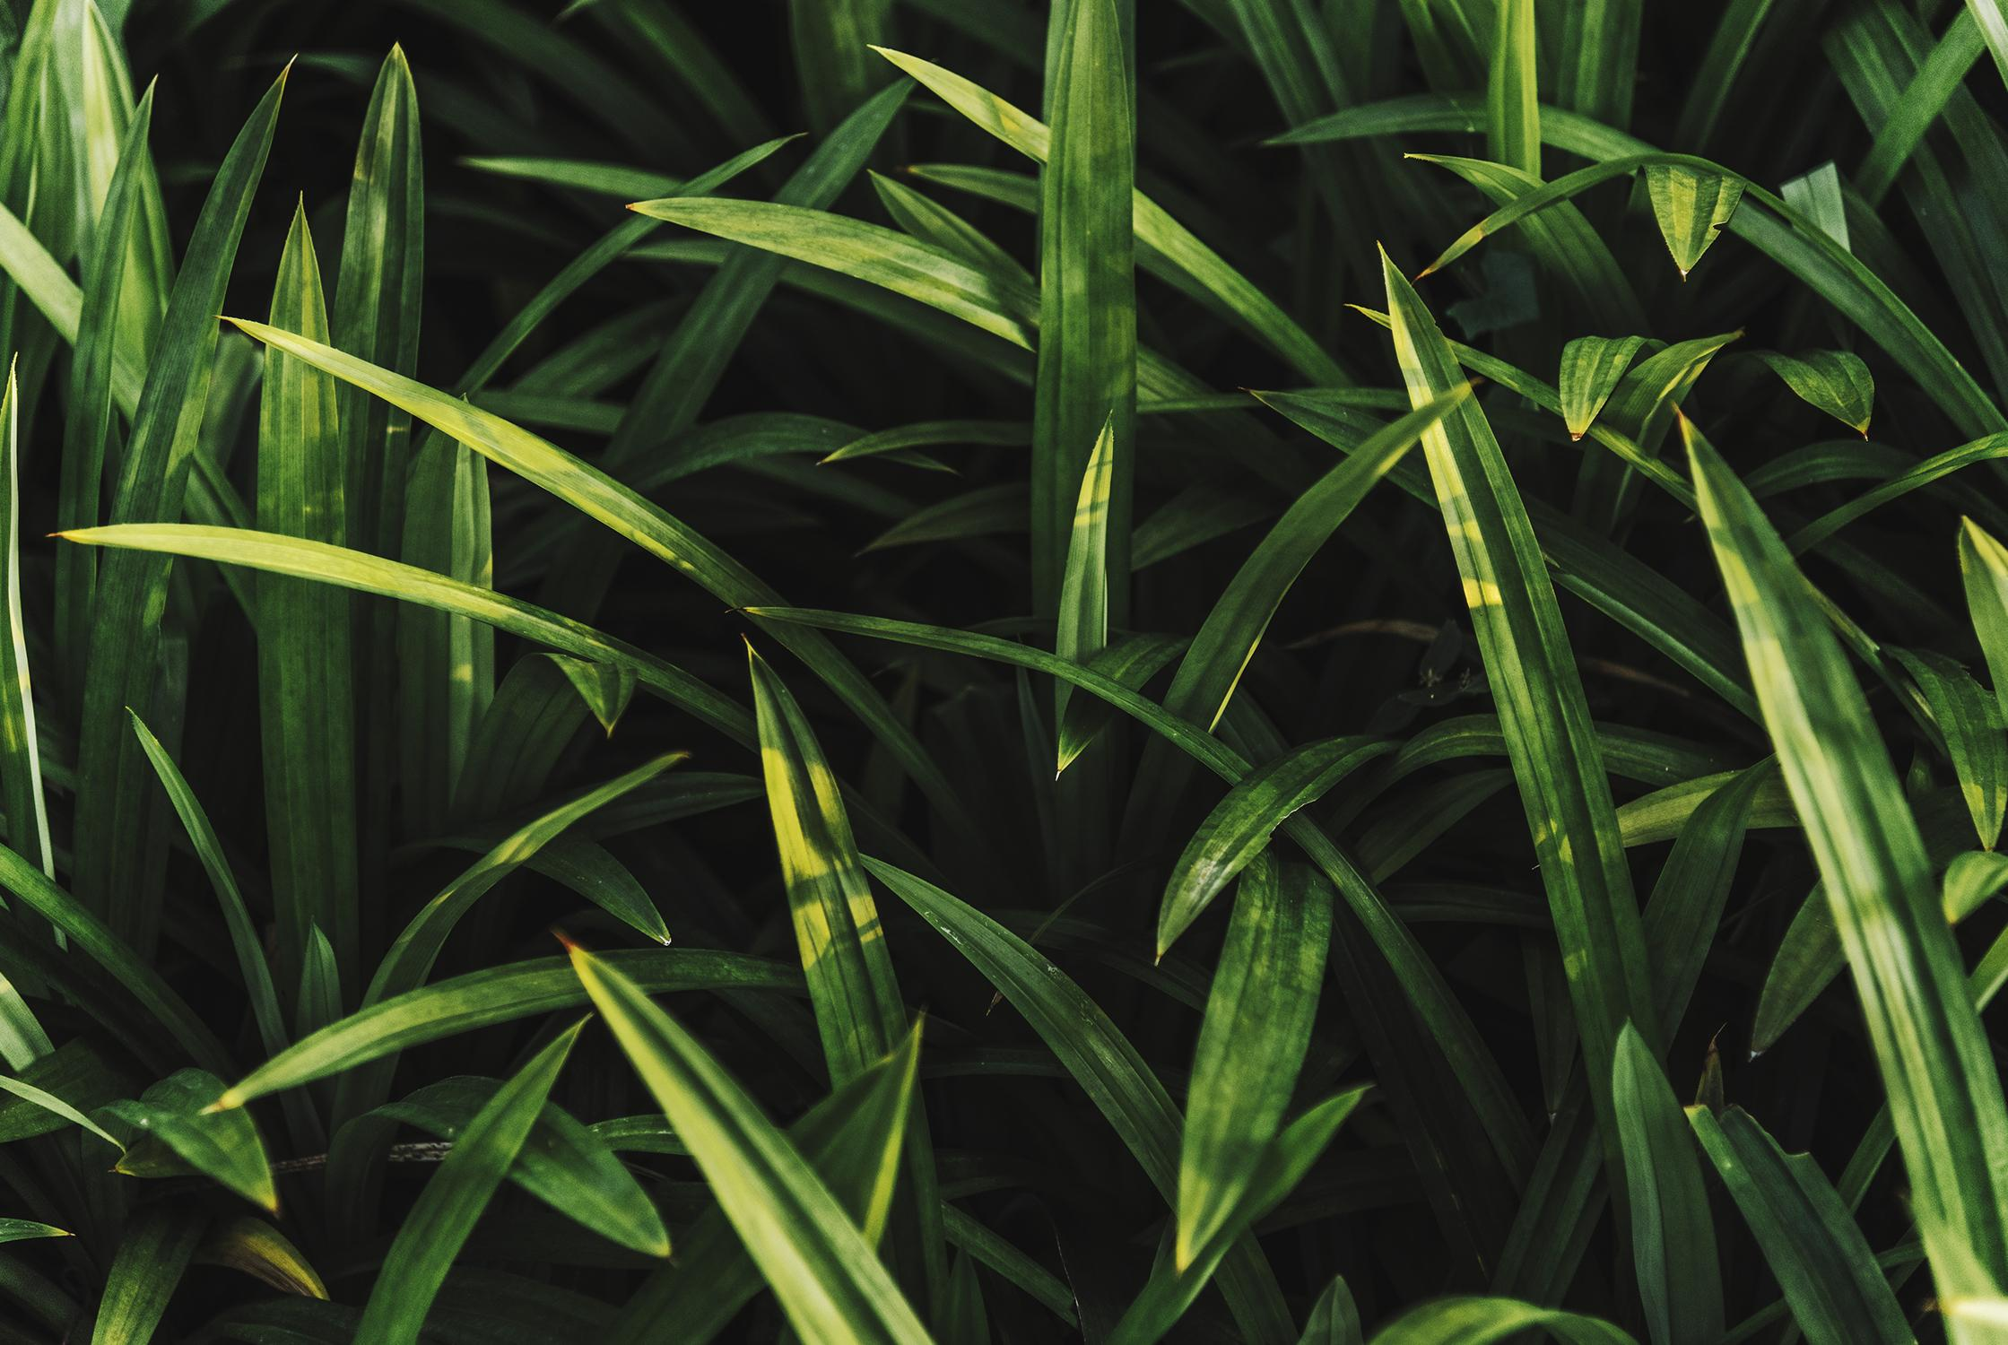

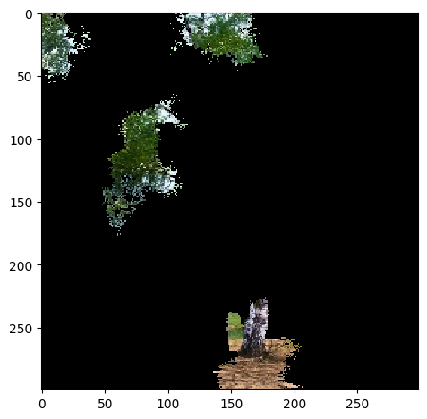
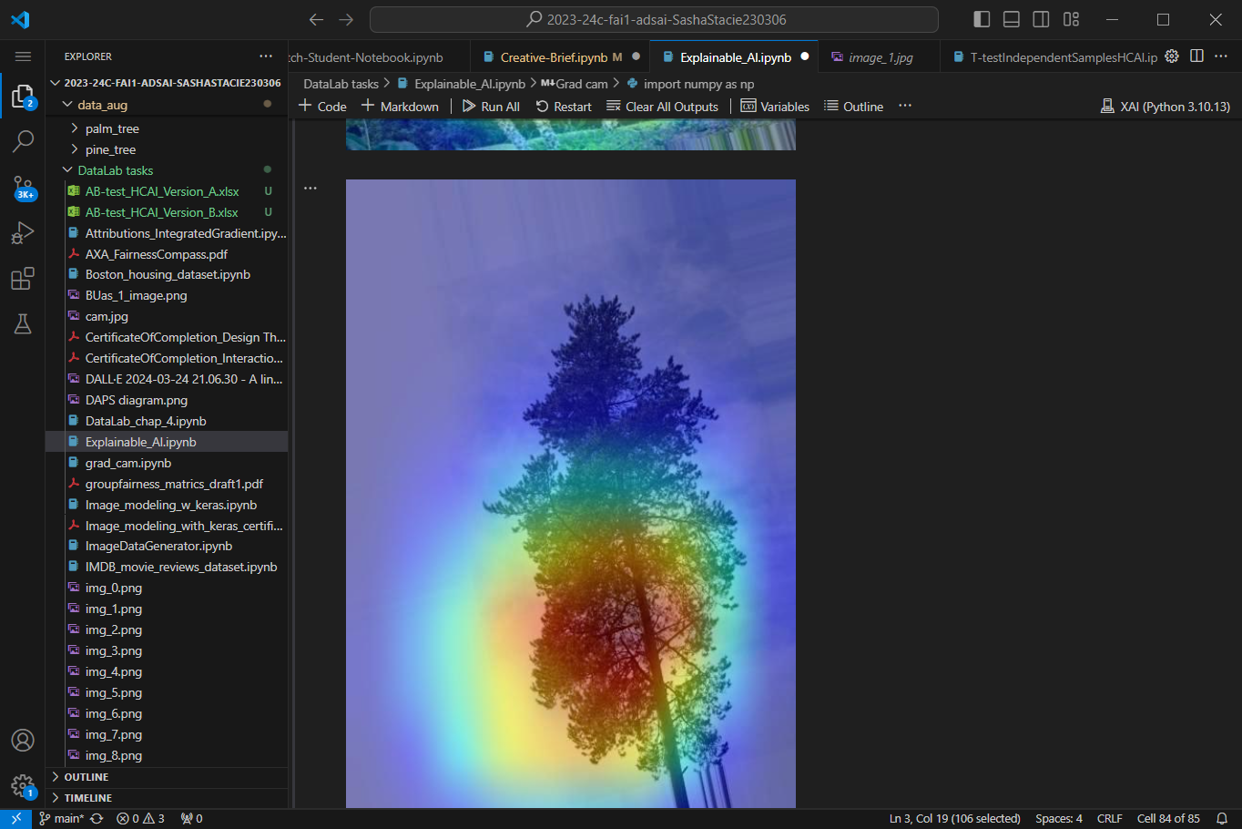
Enhancing Model Transparancy with Explainable AI
LIME
(Local Interpretable Model-agnostic Explanations)
Grad-Cam
(Gradient-weighted Class Activation Mapping)
Breaks down the prediction decision for individula images, highlighting which features lead to specific classifications.
Uses heatmaps to visually indicate which parts of the image most influence the model’s decisions.
7
Notes:
Explainable AI Methods Applied:
"LIME (Local Interpretable Model-agnostic Explanations) and Grad-CAM (Gradient-weighted Class Activation Mapping) provide the groundwork for transparency of my model.“
LIME: "Breaks down the prediction decision for individual images, highlighting which features lead to specific classifications."
Grad-CAM: "Uses heatmaps to visually indicate which parts of the image most influence the model's decisions, focusing on identifiable tree features like leaves and bark textures.“ There appears to be a pattern where the model focuses on areas with more complex textures or edges, such as clusters of leaves or the intersection of branches. This could indicate the model is using texture and shape information to differentiate between tree types.
The heatmaps shows that the model seems to focus on regions with a lot of leaf and distinct tree outlines, which are essential for differentiating between different species of trees. The model appears to be primarily focused on tree attributes, as seen by its lack of distraction from the background or other less important features.

Slide 8
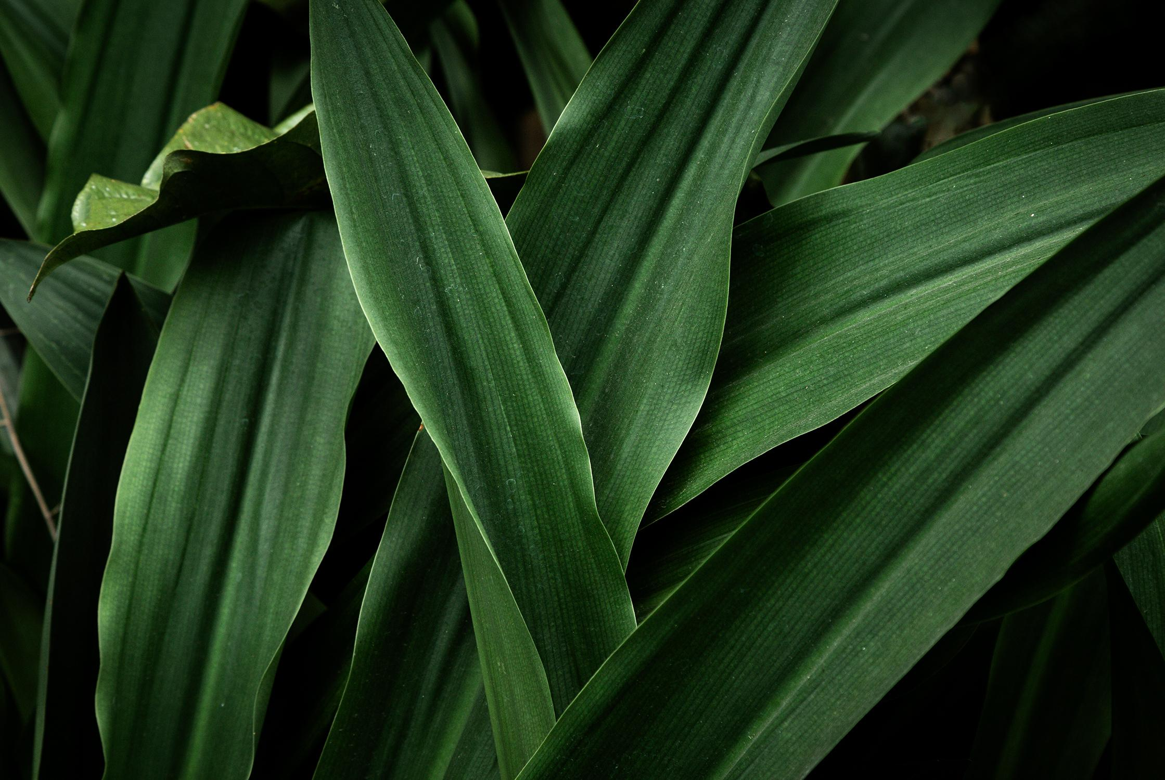
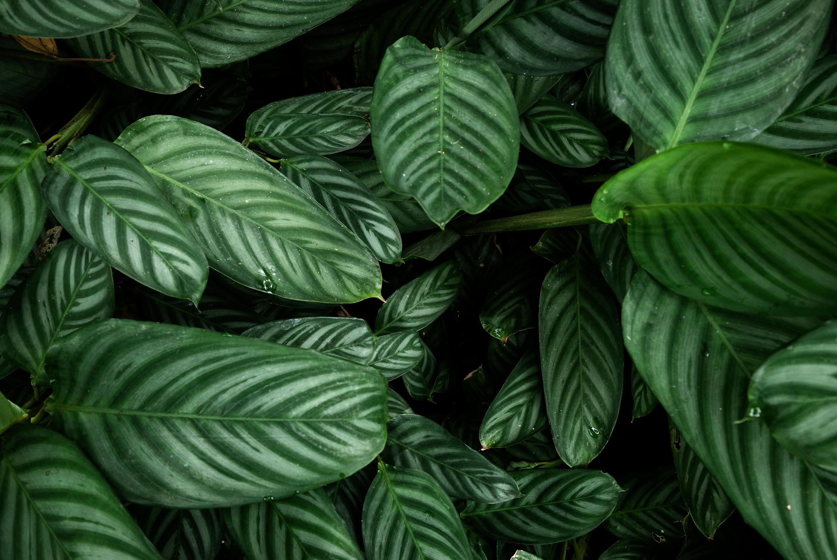
Overview of Think-Aloud Study Results
Navigation and UI
Photo Upload and Identification Process
App Name and Barnding
Aesthetic Enhancements
8
Notes:
App Name and Branding: "Changed from a generic name to 'Arboreal' for better recall and brand identity."
Navigation and UI: "Simplified the navigation through a dedicated menu page, enhancing user experience."
Photo Upload and Identification Process: "Integrated a feature to snap pictures directly within the app, simplifying the tree identification process."
Aesthetic Enhancements: "Improved visual appeal with coloured background and interactive icons to boost user engagement."

Slide 9
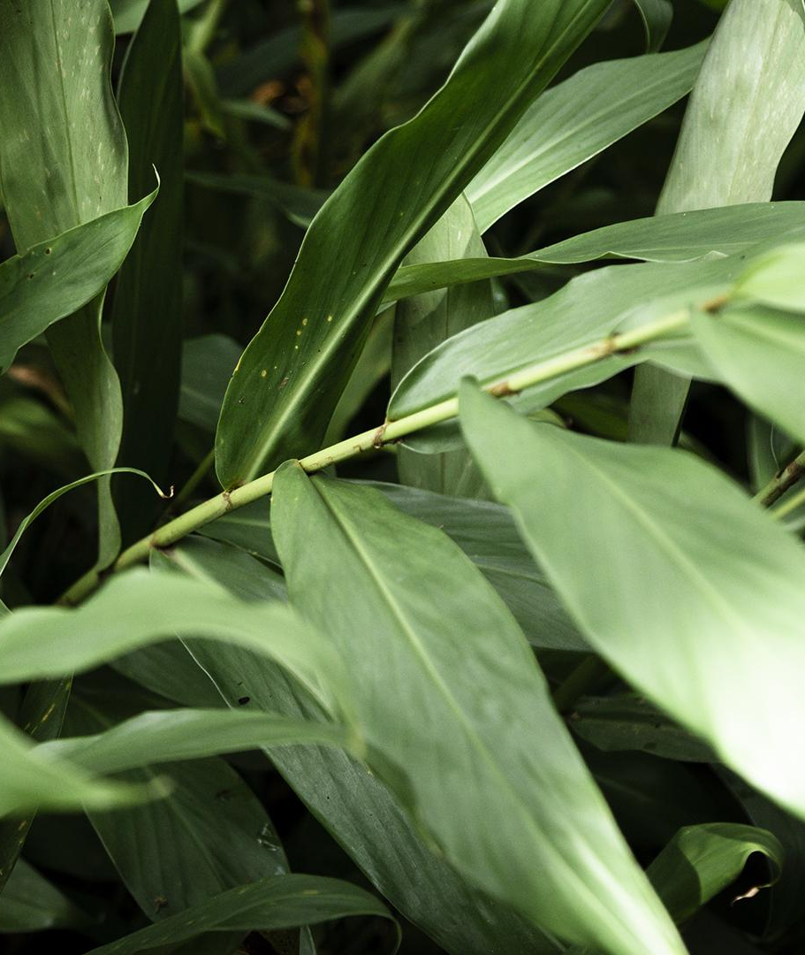
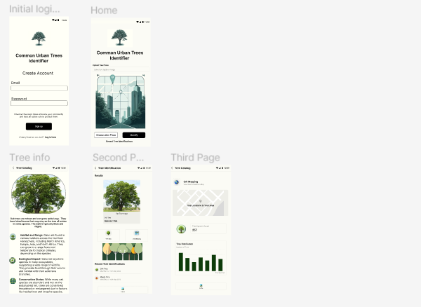
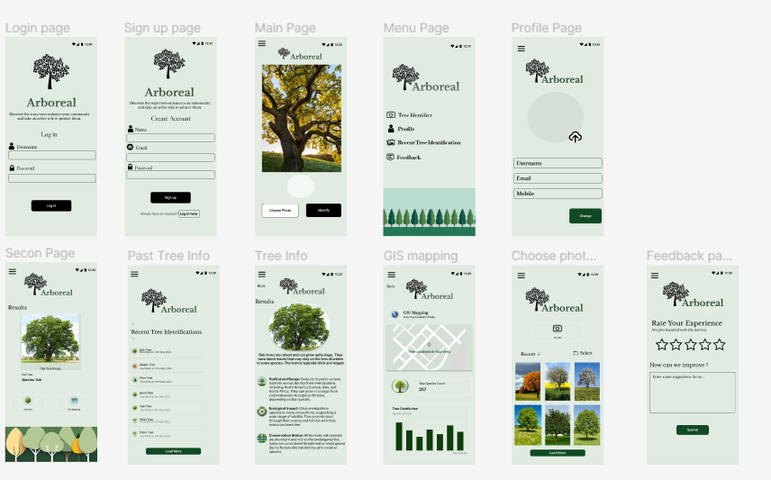
Final Wireframe Protoype
User-Centric Design
Dedicated Menu Page
Enhanced Photo Upload Functionality
Visual and Aesthetic Updates
Key Improvements Highlighted
9
Notes:
Incorporating Feedback into Design:
"Each feedback point from the think-aloud study directly influenced specific enhancements in the final wireframe prototype."
Key Improvements Highlighted:
Dedicated Menu Page: "Central access point for all features, addressing previous navigation confusion."
Enhanced Photo Upload Functionality: "Immediate photo capture capability within the app, improving user interaction and efficiency."
Visual and Aesthetic Updates: "Updated design elements to make the interface more inviting and enjoyable for users.“
Hypotheses and Prototype Testing:
My hypothesis is Enhanced usability and appealing design will lead to increased user satisfaction and engagement."

Slide 10
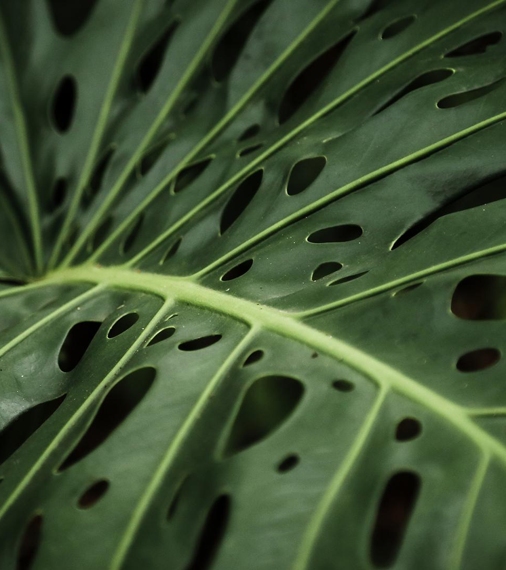
Final Demo Video
Arboreal App
10

Slide 11

Thank you!
11

